Slide 1
Notes:
‹#›

Slide 2
DevOps for .Net
Giorgio Desideri
Notes:
‹#›

Slide 3
What is DevOps ?
Notes:
‹#›

Slide 4

Notes:
‹#›

Slide 5
Meaning & Concepts
DevOps is a set of practices that combine
Software Development (Dev)
AND
Information-technology operations (Ops)
which aims to shorten the systems development life cycle and provide continuous delivery with high software quality.
https://en.wikipedia.org/wiki/DevOps
Notes:
‹#›

Slide 6
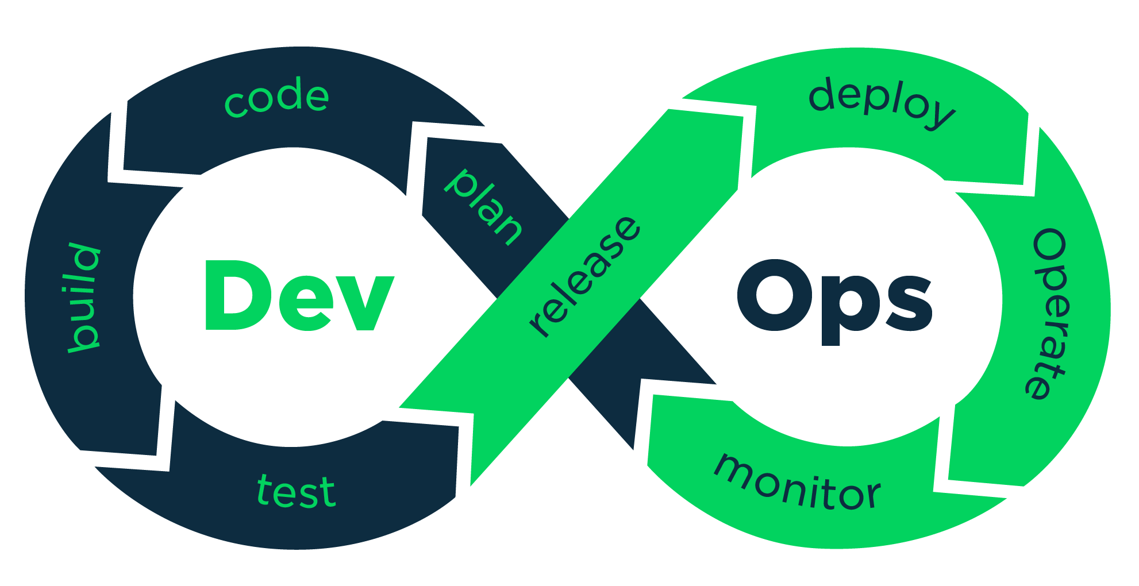
Meaning & Concepts
Notes:
‹#›

Slide 7
What does it mean ?
Notes:
‹#›

Slide 8
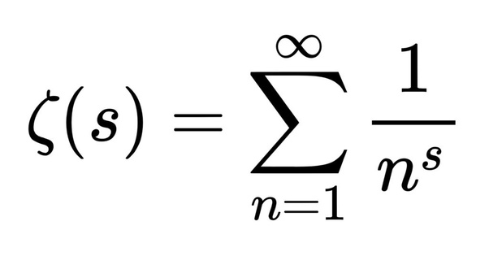
Notes:
‹#›

Slide 9
DevOps : Management
Communication improvements
daily stand-up
increase frequent feedbacks loops
Documentation is required
Collection of small documents
Project Management Triangle
Cost / Time / Scope
Notes:
‹#›

Slide 10
DevOps : Development
Coding
Acquire and manage the system knowledge
Infrastructure or Operational teams “understanding”
Compile & Build
it works on my machine
Production environment ? Is not the same of my machine o.0 ?
Test
The tester or Test team is my enemy
Functional testing is the only test that I want
Notes:
‹#›

Slide 11
DevOps : Operations & Maintenance
Release & Deploy
Cloud or not Cloud ?
How to do DevOps for THAT project ? The 99.9% of the case is required not optional
Operate & Monitor
When THIS happens what need / have to do ?
How can I check THIS, THAT, THOSE and THESE things ?
Drop Database at 03:33 AM = action required [ CALL GIORGIO ]
Notes:
‹#›

Slide 12
How to do ?
Notes:
‹#›

Slide 13
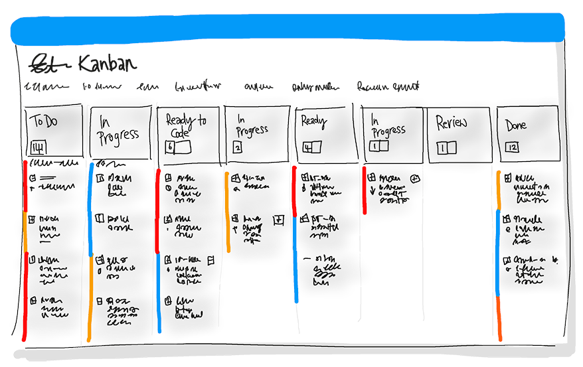
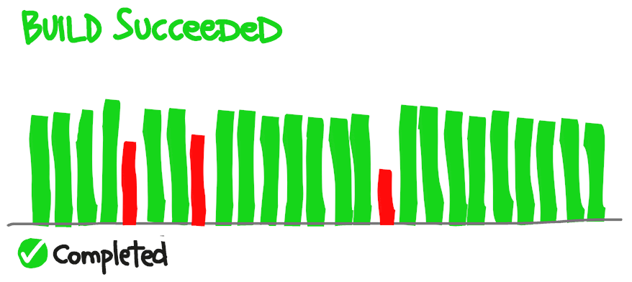
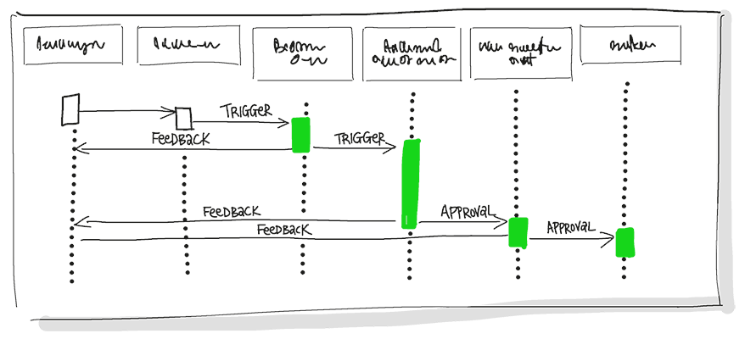
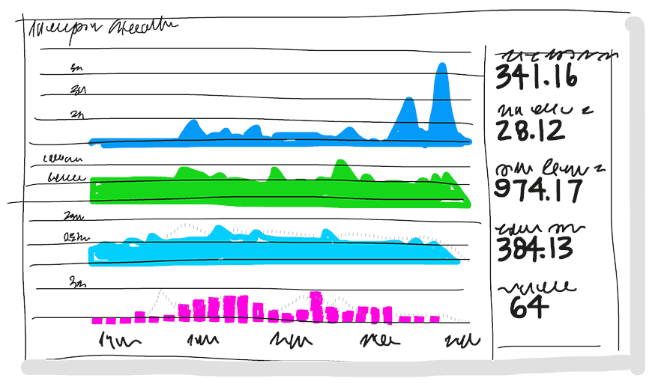
All of them !
Agile Project Management
Continuous Integration
Continuous Delivery
Logging and Monitoring
Notes:
‹#›

Slide 14
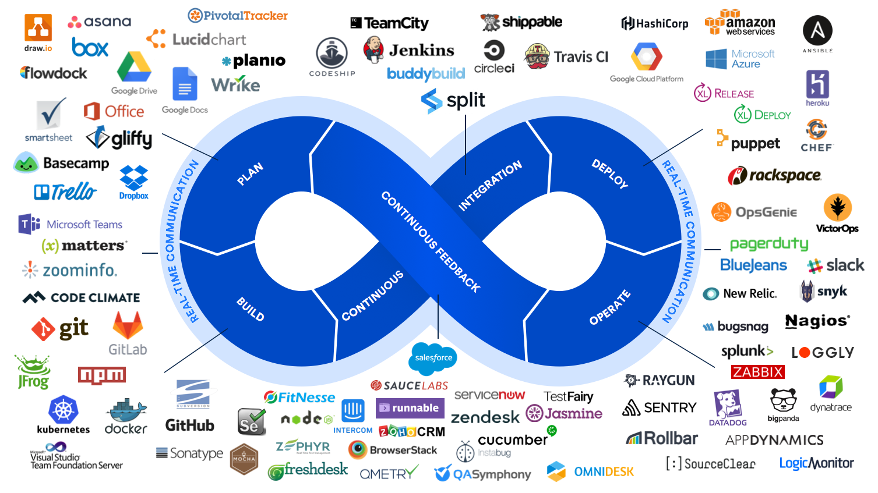
Notes:
‹#›

Slide 15
DevOps and .Net
Code
Visual Studio is the IDE not the ALL-IN solution(s)
Notepad does it better
Clean code approach
Good == ( fast & better),
Fast != ( good & better )
Space and Time complexity
O(n) the almighty stranger
Notes:
‹#›

Slide 16
DevOps and .Net
Compile & Build
R2R and AOT :
dotnet publish -c Release -r win-x64 --self-contained true
Docker :
FROM mcr.microsoft.com/dotnet/core/sdk or aspnet
Specific VM
Legacy in ASP.NET or older version
Notes:
‹#›

Slide 17
DevOps : .Net
Test
unit testing
xUnit,
nUnit
MSTest
functional testing
“Gold & Shadow” dataset
integration testing
Flying Monkey (mock)
Notes:
‹#›

Slide 18
DevOps : .Net
Release & Deploy
Versioning:
git release
git tag -a “...” -m “This is my release”
Deploy :
pipeline (cloud service, CI/CD tool)
Azure Pipeline
AWS CodeDeploy
Google AppEngine
Jenkins, Travis-CI, BitBucket, GitLab, etc.
Notes:
‹#›

Slide 19
DevOps : .Net
Operate
the people that use the software have different knowledge and tools
“tricky” workflows to fulfil the client troubles
force the system into states never planned
documentation provisioning
automation regarding changing and what document have to change
README.md is good but not enough
Notes:
‹#›

Slide 20
DevOps : .Net
Monitoring
Audit, Logging and Tracing
Azure Event Grid
Azure Event Hub
Azure AppInsight
AWS Cloudwatch
AWS X-Ray
AWS CloudTrail
Data collection
Statistics of usage
User Profiling
Data Domain Analysis
Notes:
‹#›

Slide 21
Questions and Answers
Notes:
‹#›

Slide 22
Thank you for joining us!
Notes:
‹#›

